Slide 1

Adult Income – A Tale of Gender
Notes:
We’ve heard there’s a wage gap between males and females, but is that really true? What if we look at some US census data, albeit some older data, approx 30 years old now.

Slide 2
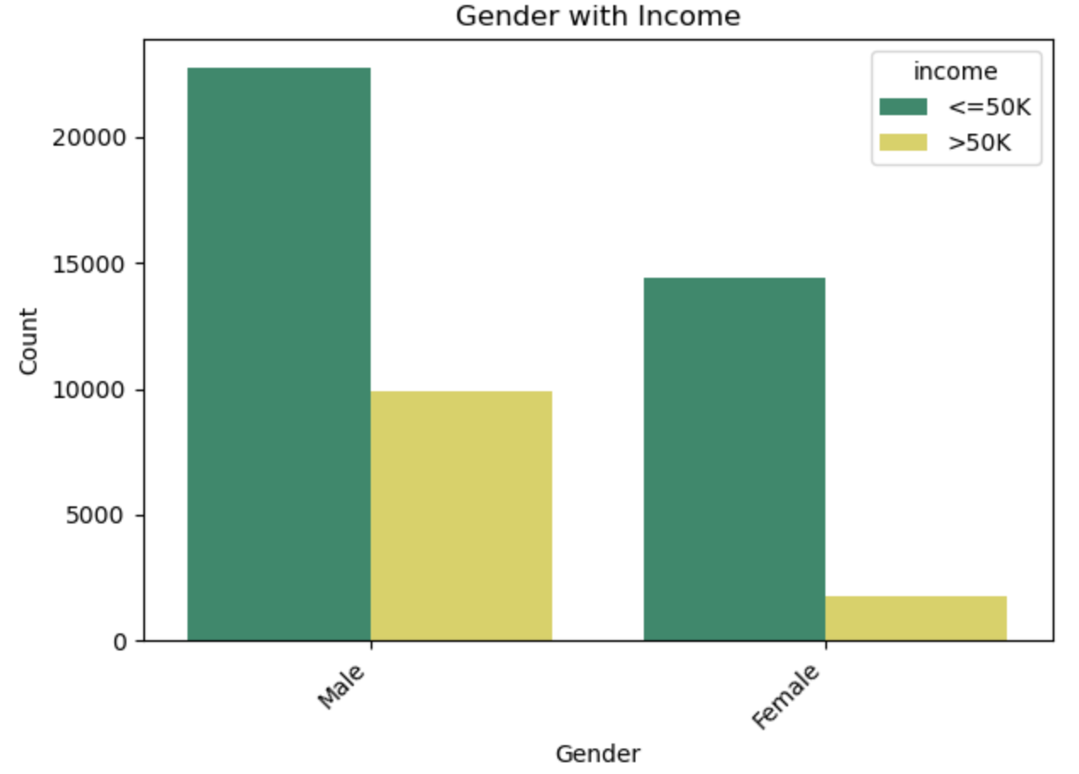

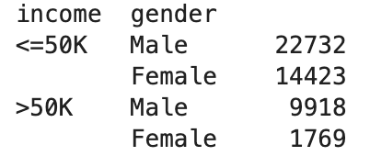
Notes:
You can see that females meeting the income threshold of greater than 50K are a small set of the population caught in the census. It’s less than 1/5 of males making the same threshold. Out of all females less than 11% make more than 50K, whereas with men it’s around 30%.

Slide 3
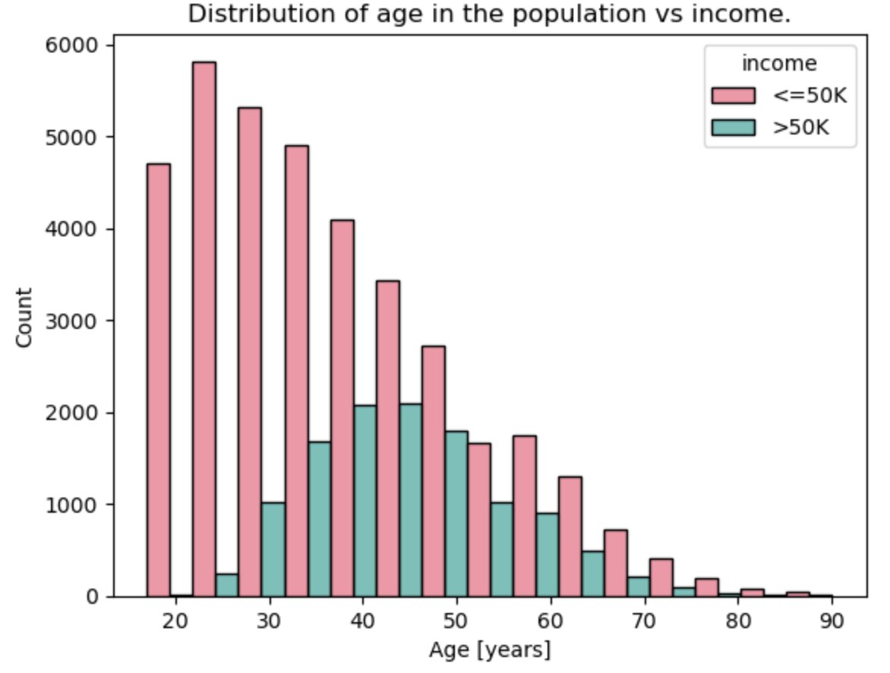
Notes:
You can see in the graph above that people are more likely to reach the income threshold level of greater than 50K once they get to their mid 30's through their mid 50's. Considering the arc of professions and occupations that makes sense for when people earn the most in their fields.

Slide 4


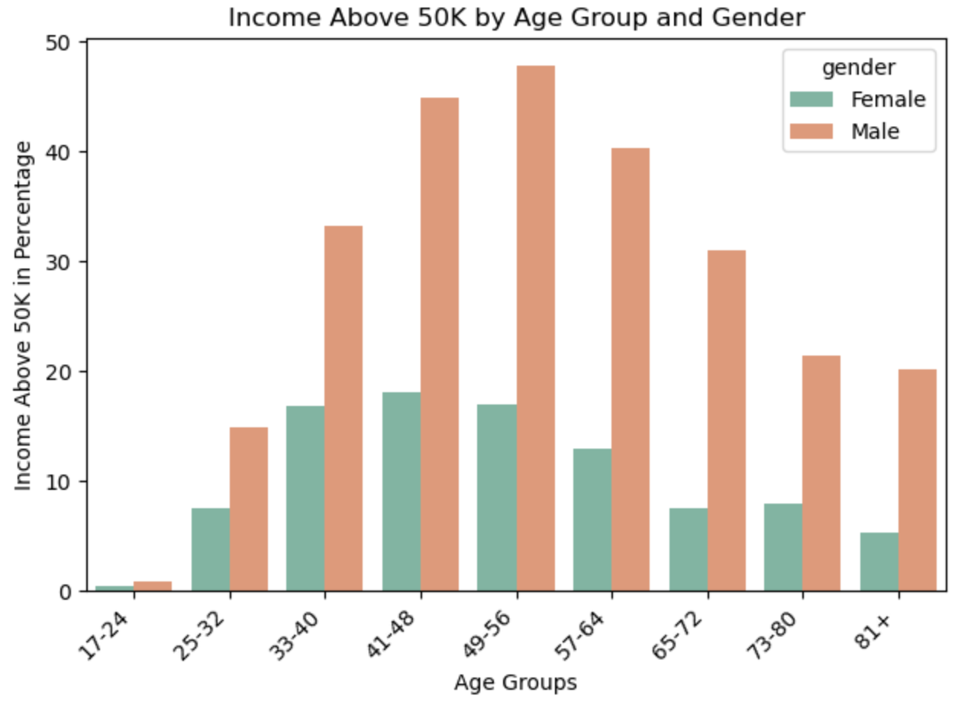
=
Notes:
When you compare these graphs you can see that actually it’s really only men who have the regular distribution that is captures on the previous slide. Women of all age groups tend to stay below 20% reaching the above 50K incomes threshold.

Slide 5
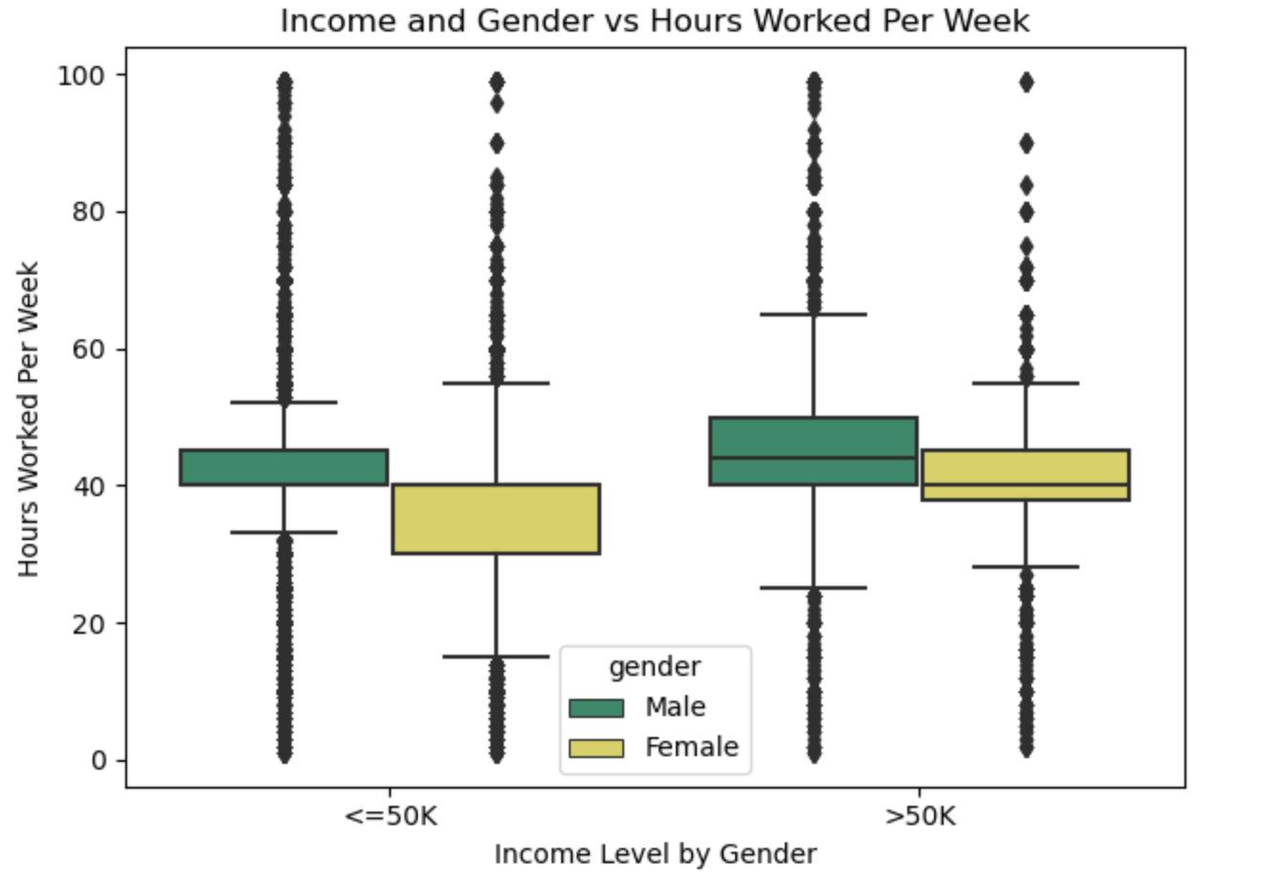
Notes:
You can see with the above graph that 75% of women who earned less than 50K worked less than 40 hours whereas about 75% of men that earned less than 50K worked typically between 40-50 hours. For the women that earned over 50K, 75% of them worked just under 40 hours a week to approximately 55 hours per week. Men that earned over 50K had 25% of them working for as many as 50-70 hours per week.

Slide 6
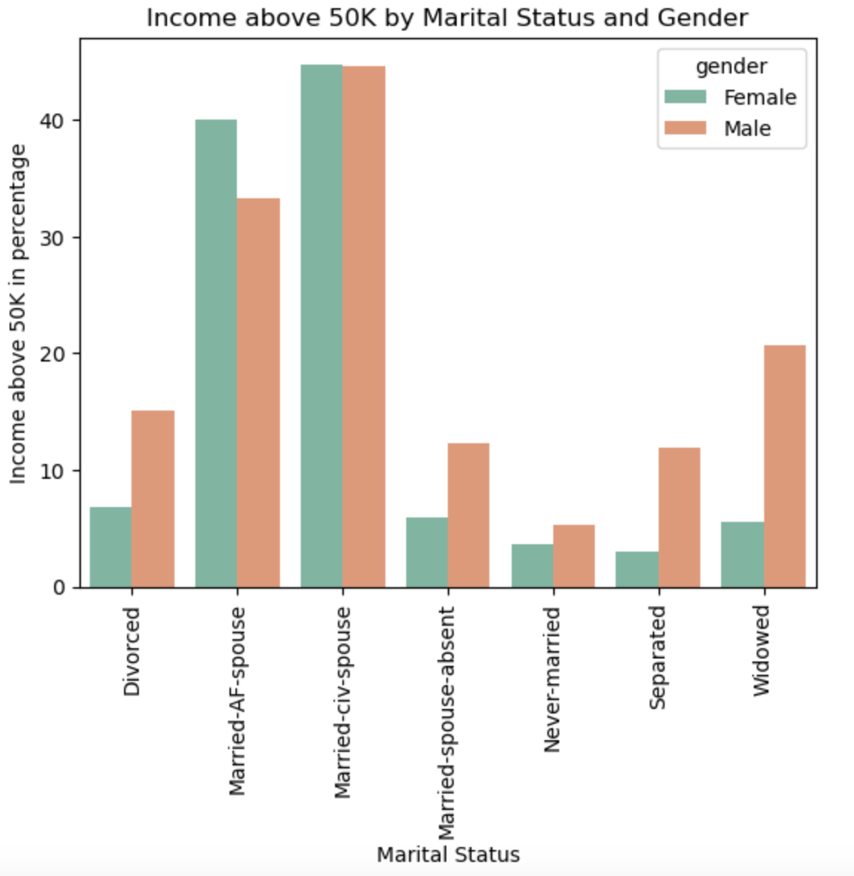

Finally some equality!
Notes:
Based on this you can see that women and men have the highest likelihood of reaching the 50K threshold for income if they are either Married while "Absent From Spouse" or married with a "Civilian Spouse". Women in particular have a much higher percentage for the 50K income threshold in these categories, which is definitely a marked difference especially when compared to how few women reach the 50K income threshold in the other graphs

Slide 7
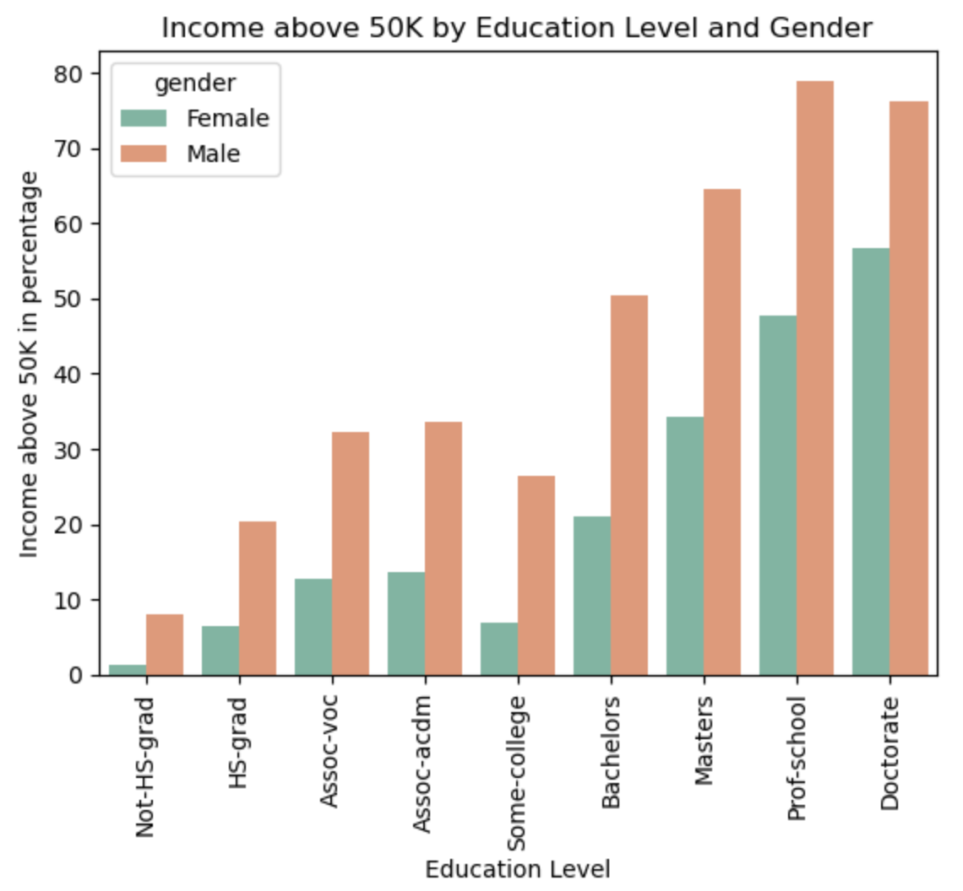

Notes:
You can see here that both genders have a much higher percentage for making the 50K threshold for income once a masters level education is achieved althought women are still trailing behind men even with similar education levels.

Slide 8
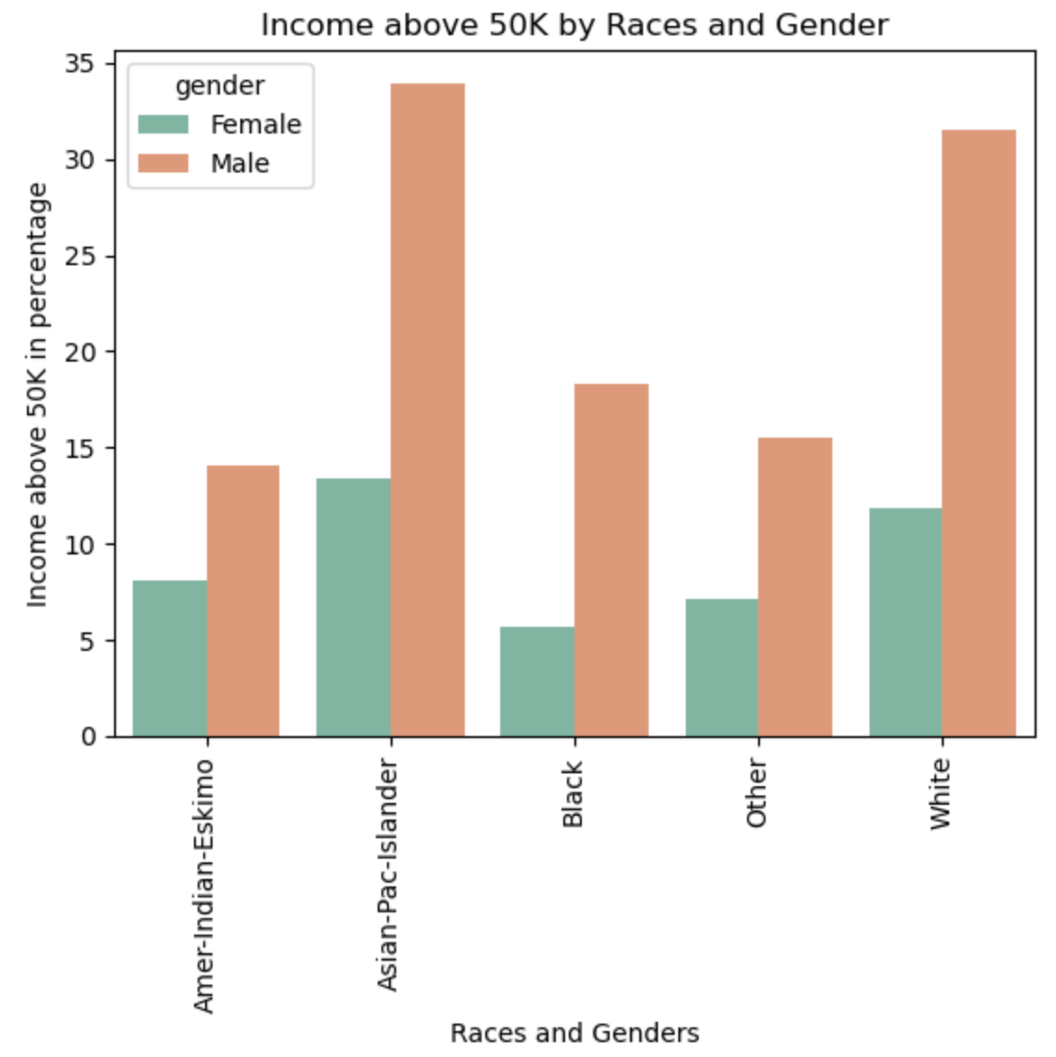
Notes:
Based on this graph you can see that race and gender plays a role in the percentage of earners that reach above the 50K income threshold. Men that identify as Asian-Pacific Islanders and White are almost twice as likely from the other groups to reach that income level. Women of all races don't have even as high of a percentage for making the above 50K threshold as the lowest percentage group for males (American-Eskimo males).

Slide 9

We need to continue working for income equality between genders and races.
This data shows some of the gaps but there are many more that could be explored with more current and detailed data.
The first step in fixing a problem though, is identifying that it exists.

